Slide 1
Female Engagement Teams
(FET)
LisaRe Brooks, Ph.D.
COIN Academy
October 28, 2010
Human Terrain Systems
HTAT Social Scientist
Bagram, Afghanistan

Slide 2
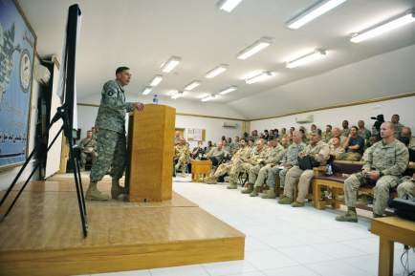
“The decisive terrain is the human terrain. The people are the center of gravity. Only by providing them security and earning their trust and confidence can the Afghan government and ISAF prevail.” (General Petraeus, August 01, 2010)

Slide 3
Command Guidance and Female Engagements
HQ IJC//FRAGO/507-2010- 121037D+30 SEP 2010
  Key Tasks:
    Conduct female engagement in support of BSO requirements.
    Conduct female engagement to achieve campaign plan objectives.
    Conduct female engagement in a culturally sensitive manner.
    Support concerning GIRoA and Afghan female population.
    Leverage the accepted influence of females with Afghan society.
MG Campbell, HQ, CJTF-101 FRAGO 587- 51545OCT10
  TASK 1: Implementation of Female Engagement Support to GIRoA.
  TASK 2: Provide PRT Command BackBriefs.
  TASK 3: Command Information Tracker Due-outs.
Brigades

Slide 4
Why Engage with Afghan Females?
Female engagements are an integral component of COIN by:
  Embracing & understanding the missing 50% of the population.
  Building relationships with the Afghan women to earn their trust, give them confidence in GIRoA, and divide them from those that violate their constitutional rights.
  Empower them to have a voice and ownership in solutions for problems in their families, villages, country.
Desired Endstates:
  Women influence families/ communities not to support the Taliban.
  Women influence others (women) to demand basic services from the local government (with coalition force support).
  Women influence family and community members to support GIRoA.
  Women do not support/ enable the insurgency.

Slide 5
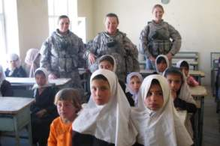
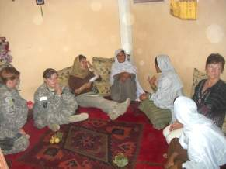
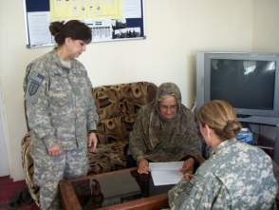
What is a “Female Engagement Team”?
Formally trained team of females that work with Afghan women and children to meet the Command’s goals.
Minimum 2 females per mission
Essential to have a female linguist
Tailored to BSO needs
If possible:
  Female medic
  ANSF female partners
  Female GIRoA officials

Slide 6
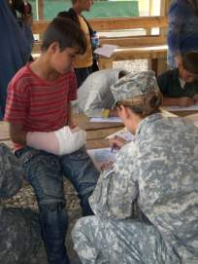
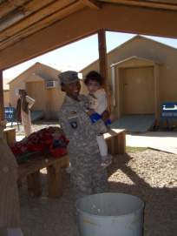
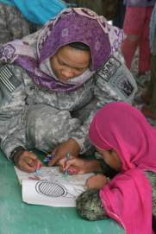
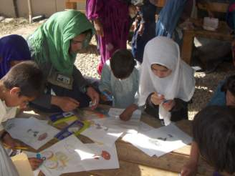
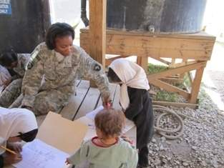
Requirements for FET Members
Top 5:
Volunteer
Mature
Adaptive
Patient
Motivated
Other:
Creative
Empathetic
Appropriate Rank

Slide 7
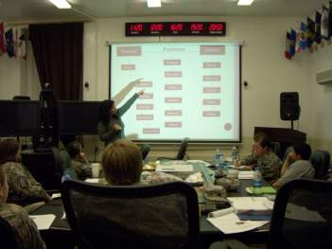
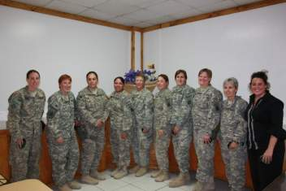
Current FET Training
IJC Directives 507-2010
  Engagement techniques (6 hrs)
  Cultural Sensitivity (5 hrs)
  Language-Dari/ Pashto (10 hrs)
  Information Collections/ Reporting (6 hrs)
  Tactical Patrolling, Movements, basic defensive skills (within unit)
  Practical Examination (3 hrs)
Expanded Topics
  CERP/ NGOs in AO (2 hrs)
  Medical Care in Villages (2 hrs)
  Practical Study at hospital (6 hrs)
Important Issues:
  Kinetic vs nonkinetic missions
  Physical demands
  Psychological demands

Slide 8
Reporting Requirements
HQ CJTF-101 OPORD 10-01
  October 15, 2010 FRAGO 587 to CJTF-101 OPORD 10-01
    CIDNE
    WORD docs to POC (monthly reporting)
  Relevant event information, atmospherics, future events, lessons learned, way forward
  Division Weekly Rollup to IJC and above
  Information versus Intelligence
Information Sharing vertically and horizontally
Shared in a timely manner
“Success requires communication, collaboration, and cooperation.” (General McChrystal)

Slide 9
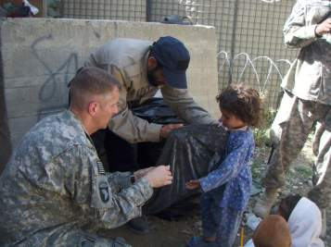
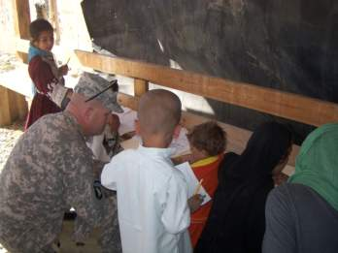
Place for Men and FETs
Include Tribal Elders/ Mullahs
  Understanding Afghan Rights
Include husbands/ brothers/ uncles
  Understanding Resources
Empower the women through the men
Opportunity to identify the needs of the Family and Village

Slide 10
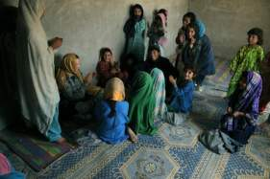
PRTs and FETs
Female Engagements
  Combined effort to develop positive relationships
  Dedicated to enhancing lives of Afghan people
  Understand the female perspective and how to empower them to have a voice and ownership in solutions for problems in their families, villages, country.
FRAGO 587
  PRT members may be used for Female Engagements
    KLEs; Shuras; Developmental activities; etc.
  Reporting Requirements
    Monthly (CIDNE/POC) reporting of engagements, atmospherics, information, future events
  Facilitate Coordination and Cooperation of activities
  Outgoing PRT CDRs provide Command Back Briefs: EXSUM, AAR, & Lessons Learned
(U) Zabul PRT, July 08, 2010

Slide 11
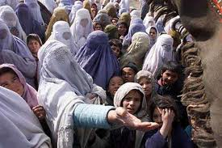
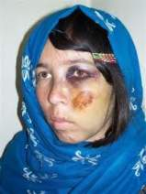
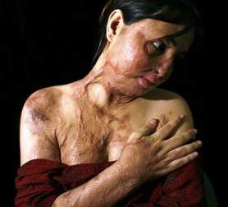
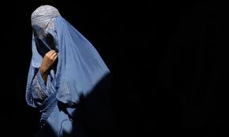
What to expect in your AO
Specific Female Issues:
  Poverty
  Poor access to clean water
  Malnutrition/ Disease
  Widows
  Drug addiction
  Physical/ Sexual Abuse
  Terrorism
  Learned Helplessness
  Suicide Attempts
  Cultural Restrictions

Slide 12
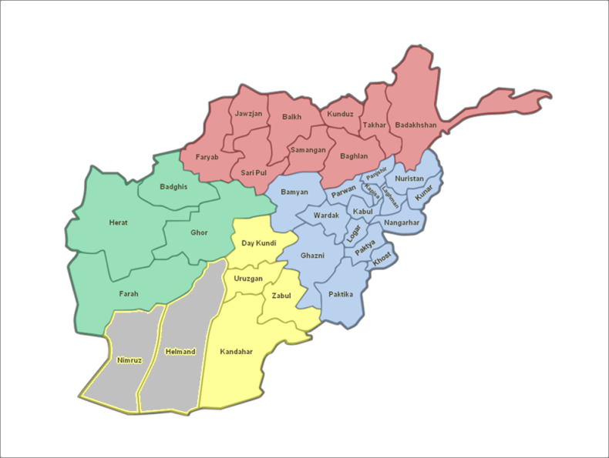
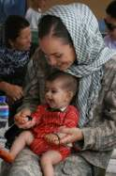
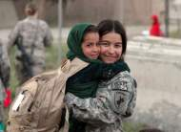
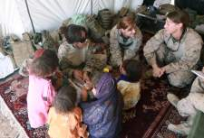
Female Engagement Teams
TF Wolverine
HTT/ HTAT
KY ADT
Korean PRT
Parwan CMST
Bagram AFB
Kapisa PRT
HTT- AF14
Parwan PRT
Kunar PRT
RC-N
Laghman PRT
Nangahar PRT
RC-E
RC-S
TF Rock MISO
RC-SW
RC-W
Ghazni PRT
2nd MEB-A
HTT-AF6

Slide 13

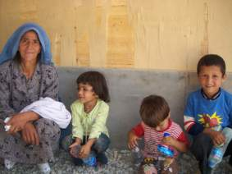
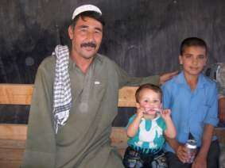
FET ”LOOKING FORWARD”
FAMILY
EMPOWERMENT
TEAMS

Slide 14
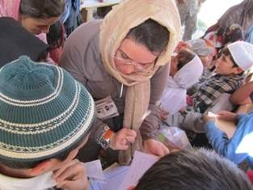
POC:
LisaRe Brooks, Ph.D.
Social Scientist
Human Terrain Analyst Team
Bagram, Afghanistan
DSN: (318) 431-2185
lisare.brooks@afghan.swa.us.army.mil
Many Thanks to:
LTC Wolfgang
TF Wolverine
COIN Academy Staff

Slide 15
Recommended Reading/ Viewing
Books / Articles
A Bed of Red Flowers: In Search of My Afghanistan: Nelofer Pazira
A Woman Among Warlords, Malalai Joya
Behind the Burqa, Sulima, Hala, & Batya Yasgur
Freedom and Culture, John Dewey
Half The Sky, Nicholas Kristof & Sheryl WuDunn
Kabul Beauty School, Deborah Rodriquez &
  Kristin Olson
Kabul in Winter, Ann Jones
Land of the High Flags: When the Going was Good, Rosanne Klass
Meena: Heroine of Afghanistan, Melody
Ermachild Chavis
My Forbidden Face, Latifa, Shekeba Hachemi, & Linda Coverdale
Religions, Values, and Peak Experiences,
A.H. Maslow
The Booksteller of Kabul, Asne Seierstad
The Disappearance, Philip Wylie
Books / Articles, cont.
The Swallows of Kabul, Yasmina Khadra
The Three Women of Herat,
  Veronica Doubleday
Veiled Threat: The Hidden Power of Women in Afghanistan, Sally Armstrong
Women and Nation Building, Cheryl Benard
Women for Afghan Women, Sunita Mehta
Women of Afghanistan, Isabelle Delloye
Women of Afghanistan in the Post-Taliban Era, Rosemarie Skaine
Women of Courage, Katherine Kiviat &
Scott Heidler
Zoya’s Story, John Follain & Rita Cristofari
Movies
Osama, Siddiq Barmak
The Beauty Academy of Kabul, Liz Mermin
Iron Jawed Angels, Katja von Garnier
The Stoning of Sorya M., Zahra
Lioness, Meg McLagan and Daria Sommers

